Slide 1
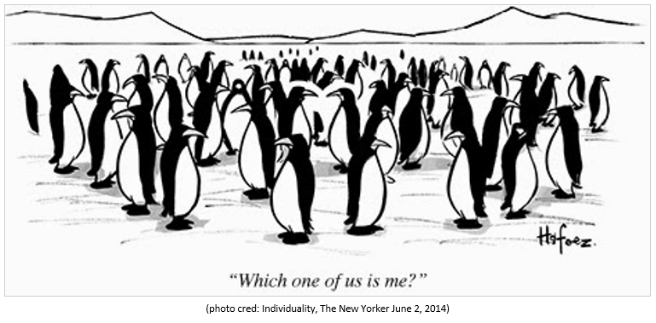
Social identity

Slide 2
THE question
How do I define myself through the groups I am part of?
What part of your identity do you think people first notice about you?
What part of your identity are you most comfortable sharing with other people?
What part of your identity are you least comfortable sharing with other people?
What part of your identity are you most proud of?
What part of your identity did you struggle the most with growing up?
What part of your identity is the most important to you?
What part of your identity is least important to you?
What part of other people’s identities do you notice first?
For what part of your identity do you feel you face oppression for most often?
For what part of your identity do you feel you receive privilege for most often?
For what part of your identity do you feel least comfortable with at U of M?

Slide 3
Through others we become ourselves. ― Lev S. Vygotsky
Social identity is a person’s sense of who they are based on their group membership(s)
Notes:
Social identity relates to the perception of oneself and others based on the social groups that they belong to. It relates to how one relates to a certain social group, and how that relation determines the way the person behaves towards other individuals in the same or different social group. It relates to how one's viewpoint is influenced by the collective values of the group.

Slide 4
In-groups and out-groups
The groups that one is associated with are called 'in-groups‘
The groups that the person is not associated with are called 'out-groups'.
This inter-group behavior is explained via the social identity theory (SIT), which elucidates how the positive interaction with members of the in-group and the negative attitude towards the out-group help define the self-identity and self-esteem of the person.
Notes:
The individual perceives itself to be similar to the people of the in-group, but radically different from the people of the out-group.

Slide 5
Social Identity Theory
Social identity theory originated from British social psychologists Henri Tajfel and John Turner in 1979
part of a person’s concept of self comes from the groups to which that person belongs
individuals endeavor to enhance their own self-esteem, by modifying their perception of self-identity as well as social identity; e.g, a person wanting to be successful would associate and ingratiate himself within groups of successful people (in-group), while distancing himself from other struggling or non-successful people (out-group).
Notes:
An individual does not just have a personal selfhood, but multiple selves and identities associated with their affiliated groups. A person might act differently in varying social contexts according to the groups they belong to

Slide 6
Social categorization
The tendency of an individual to divide and categorize people into in-groups and out-groups. This division enhances and exaggerates the differences between the two groups, and highlights the similarities between the people of the in-group.
Notes:
This illusive diversification is also known as the 'category accentuation effect'. This effect acts to underestimate the differences within an in-group or out-group, but at the same time, it overestimates the differences between the two groups. For example, in case of students who do not study regularly, an out-group would be labeled as being losers or dull (studying is too hard for them), but an in-group would be labeled as naturally intelligent (studying is too easy for them), in order to explain the lack of regular studying. Here, all out-group members are assumed to be dull, while all in-group members are assumed to be intelligent, and incidentally, both assumptions tend to be drastically dissimilar to highlight the difference between the two groups.

Slide 7
Social Identity
The tendency of people to adopt an identity that is compatible with the views of that person's in-groups. Here, the concept of self and self-image is a moldable entity, that changes in accordance with the changes of or within the in-groups. In other words, self-identity is based on the person's membership to various social groups. This implies that, a person does not possess one concrete self-identity, but rather multiple identities, that are adopted and used based on circumstances. These multiple identities act to enhance one's self-esteem.
Notes:
A person may be part of different social groups according to his gender, age, family, ethnicity, race, region, education, aspirations, financial and social status, etc. Hence, that person would belong to multiple social groups simultaneously, with each group influencing a part or the whole of that individual's sense of self. For example, a 20-year old woman could possess an identity or identities related to womanhood, young adult, future maternal figure, student, adventurer, earning member of the family, etc.

Slide 8
Social Comparison and Positive Distinctiveness
Since self-esteem is related to social identities, one seeks multiple positive social identities. The possession of these identities leads to the generation of a comparative analysis between one's in-groups and out-groups, to firmly establish one's own superiority over other groups. This comparison enhances self-image as well as a positive social identity.
Notes:
This comparison between the social groups to establish one’s superiority result in a positive self-concept at the expense of the derogation of the out-group members. For example, in a school, the children of rich parents may possess monetary superiority over the other children, and establish themselves as being superior on the basis of accumulated wealth, thus reinforcing a positive view of self.

Slide 9
Examples of inter-group behavior
Ethnocentrism: one's own ethnic origins (in-group) are believed to be far superior in comparison to other ethnicity (out-group) in all aspects.
In-group favoritism refers to the practice of favoring an individual belonging to one's own in-group over others belonging to one's out-groups.
Stereotypes are used to categorizes sets of people based on an over-simplified image. These stereotypes are often used to establish social superiority between groups.
Conformity is the act of matching one's belief and value system to that of the norms of a group. It can be used to justify the negative behavior of people. The individual follows the actions of the group (conforms) in order to be seen favorably in the group, and to increase his own self-esteem within the group. In addition, the person also fears social rejection by the group, and hence does not question or go against the collective will of the group.
Notes:
Ethnocentrism:
All positive features of the in-group ethnicity are attributed to the natural disposition of people of that group. On the other hand, any negative feature is explained away and chalked up to situation mishaps or accidents, i.e., blame is evaded. In the case of the out-groups, the negative features are attributed to the disposition of the people, whereas, positive features are seen as accidental anomalies.
In-group favoritism: For example, while recruiting people for a position at a multinational company, an American manager may give preference to an American applicant over the applicants from other countries.
Stereotypes: For example, the common stereotypes regarding cowboys and Native Americans, establishes the cowboys as being civilized and modern, while the Native Americans as being uncouth and dull. This results in the establishment of the superiority of the cowboys over the Native Americans. It is reinforced in children role-playing games, where in a conflict between the two groups, the cowboys emerge victorious over the Native Americans.
Conformity: An apt example of this is the atrocious anti-Semitic crimes committed by numerous Germans during Hitler's dictatorship. In a bid to conform to the general agenda of Hitler's army, several individuals committed heinous acts so as to be treated favorably by their fellow individuals.

Slide 10
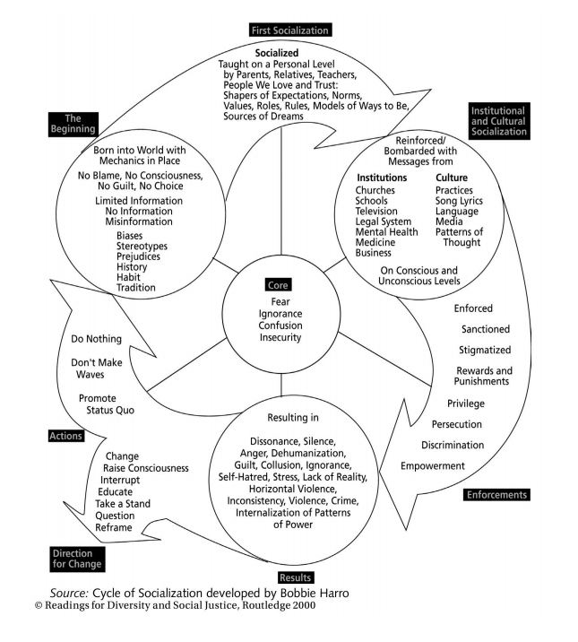
Notes:
What do you think it is saying?
Do you agree with what it’s saying?
In what ways do you think you've been socialized?
What questions do you have about it?

