Slide 1
EUROPEAN CINEMA
Interwar period

Slide 2
What is the role of cinema?
What is the relationship between politics and cinema?
How would you regard the role moving images play in:
Entertaining people
Informing people
Influencing people

Slide 3
Assignment for 2 April, 2019
Choose one film/clip from the online collection of the Imperial War Museums and analyze its content in relation to:
Its possible impact on the intended audience
Its historical accuracy
Its intended purpose
https://www.iwm.org.uk/collections/film
Please note that this assigment should be made into a short persentation (5-6 minutes, depending on the film chosen) which you have to present during the class

Slide 4
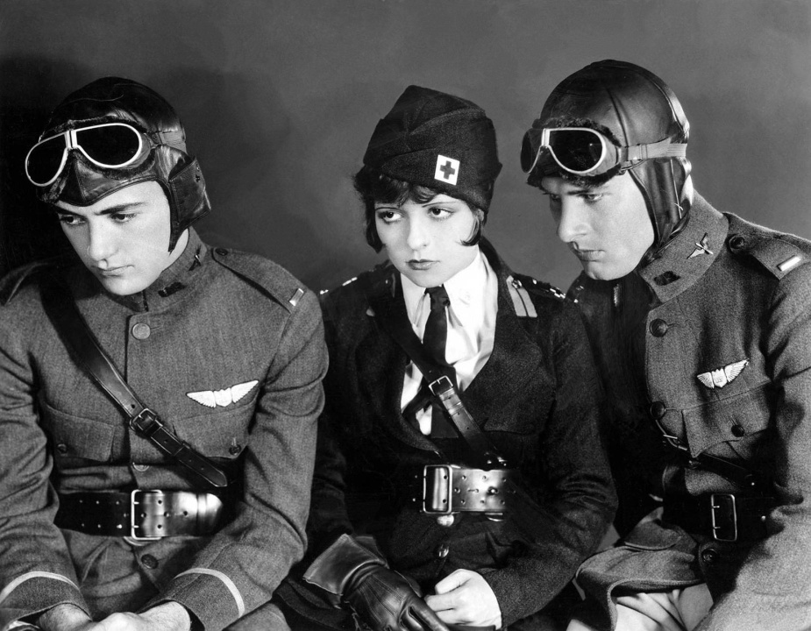
War
https://www.youtube.com/watch?v=-Tv5gBa9DQs
https://www.youtube.com/watch?v=7DAiz_KoPFY
Notes:
Battle of Somme – footage: film – direct politics – the Lumiére tradition (documentary). My brother is coming (1919) . Michael Curtis (casablanca) – shot during the time of the Hungarian Soviet Republic (literally Hungarian Rebublic of Councils) – a short-lived rump state April-August 1919.

Slide 5
Interwar period
Soviet formalism
https://www.youtube.com/watch?v=Py4IE-yFHgo&index=6&list=PLGciYgiR4atHXYqPD2QZT9nsO_86u72gu
Abel Gance: Napoleon (1927)
https://www.youtube.com/watch?v=3dzlP5pfXK4
Fritz Lang: Metropolis (1927)
https://www.youtube.com/watch?v=vLxe92EgT9Y
Jean Renoir: The Grande Illusion (1937)
https://www.youtube.com/watch?v=0BT5DX07x94
https://www.youtube.com/watch?v=hctrYzVYmfM
Notes:
Soviet:Eistenstein, montage, meaning, Renoir: During the First World War, two French soldiers are captured and imprisoned in a German P.O.W. camp. Several escape attempts follow until they are sent to a seemingly impenetrable fortress which seems impossible to escape from.

Slide 6
Assigment for 16 April, 2019
Watch „Triumph of the Will” by Leni Riefenstahl and think about the followings:
Is it a documentary or a propaganda film?
How do you think it was perceived by Germans/Austrians and by the „rest of the world”?
Do filmmakers have any responsibility in filming historical events, moments?

