Slide 1
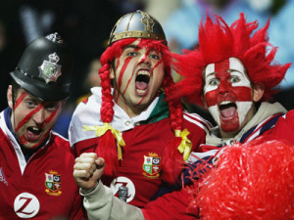
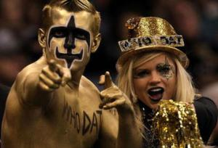
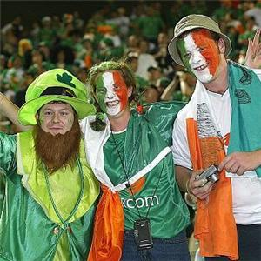
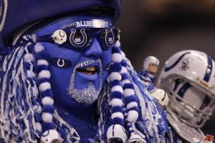
National identity and sport

Slide 2
Question
What is the relationship between sports and national identity?
What can sport tell us about changing perceptions of national identity?
What is the role of big sport events in fueling nationalism or patriotism?
What is the role of „creating” sport heroes in national identity building?

Slide 3
Sports events and politics
Events are long driven by political and ideological motives (ancient Rome and Greece, Olympic Games of 1936, 1972, 1980, 1984)
One nation concept
Sport is capable to promote a sense of national identity and projecting it abroad
„when you put on that jersey, the name on the front is more imporatnt than the name on the back”
International sport competitions are seen as a form of ritualized war

Slide 4
What is the relationship between sports and national identity?
Sports are an important component of national identity, with success by a national sporting team often seen as an indicator of the value of the nation
Sport is also important in nation-building as it helps create a national identity that distinguishes between “us” and “them,” but in a healthy, competitive setting
Today the most powerful form of national performance may be seen in sport

Slide 5
What is the relationship between sports and national identity?
Many nations have „representative sports” and respective athletes (who are frequently serve to generate the characters of a nation
The case of China: The focus on winning gold medals with the support of mobilized national resources has helped China to emerge as a major power in sport, especially in the Olympic Games. A large amount of Chinese athletes are constructed as role models, inspiring common people. Their excellent performances, on the other hand, are interpreted as a significant symbol of China’s role in global affairs
The case of the US: „The American Dream” and „Sport Heroism”

Slide 6
Sport and national identity
Most events make use of conventional symbols of the nations (flags, national costumes, national anthems, stc.) in displays of explicit nationalism
Athletes are „representatives of the nation” – their poor performance is often interpreted by the press and by people as „humiliating”

Slide 7
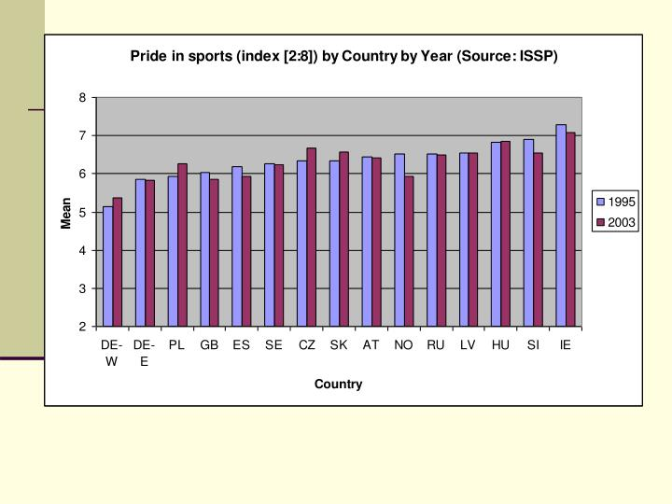
Notes:
ISSP (International Social Survey Programm) 1995 and 2003 National Identity I. and II.

Slide 8
https://www.youtube.com/watch?v=r30L7dyDib8
https://www.youtube.com/watch?v=WJgdDWQ0Y7g
https://www.youtube.com/watch?v=LwLoOfloiOE
https://www.youtube.com/watch?v=2uEpcfonkt4
https://www.youtube.com/watch?v=4ZHwdI3bh9Q
https://www.youtube.com/watch?v=kiAbtd8DDLs
https://www.youtube.com/watch?v=qtg0UJC-oX0

